Slide 1

FIRE AND LPG DETECTION AND ALARM SYSTEM
Submitted By: -
Ekhlakh Ahmad. Reg No.: - 12209166.
Abhishek Singh. Reg No.: - 12213378.
Dheeraj Kumar Reg No.: - 12208863.
Submitted To : -
Dr. Shakti Raj Chopra Sir
(Assistant Professor)
11636

Slide 2
Introduction
Begin by explaining why fire and gas detection systems are so important. They help keep us safe in homes, offices, and factories.
Talking about the dangers of fires and gas leaks, like damage and harm to people.
Say that my project helps by giving an early warning when there’s danger.
Our Project detect the leakage of LPG gas and warn the family member in the house with the buzzer alarm set on it.

Slide 3
Fire and lpg detection and alarm system using lcd and buzzer.
While LPG is an essential need of every household, its leakage could lead to a disaster. To alert on LPG leakage and prevent any mishappening there are various products to detect the leakage. Here we have developed an Arduino based LPG gas detector alarm. If gas leakage occurs, this system detects it and makes an alert by buzzing the buzzer attached with the circuit.

Slide 4
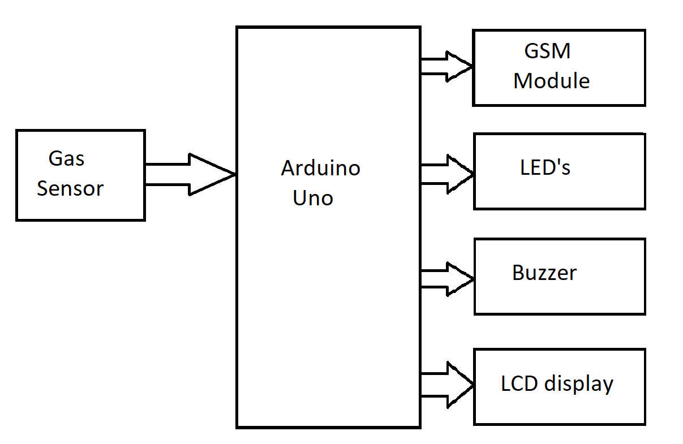
Block diagram

Slide 5
Hardware requirements
Arduino
Power supply
LPG Detector
Buzzer
LCD 16*2 or other device for message
Bluetooth module or ESP8266

Slide 6

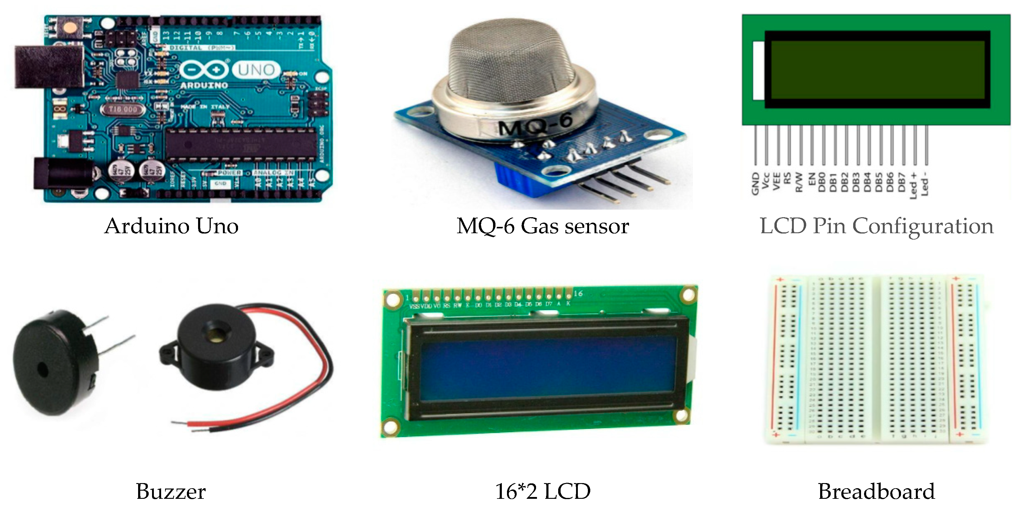

Slide 7
Software requirements
Arduino IDE
Web Application or Arduino Application
Database (In IOT cases)
Language: Embedded C

Slide 8
Lcd display
The LCD display is like the face or our system. It shows us important information using words and symbols.
When the system detects a fire, it will show a message on the screen like “Fire Detected!” this tells us there’s a fire nearby.
If there’s a gas leak, the screen will display a message such as “Gas Leak Alert!” this warns us about a gas problem.
We should always take the buzzer alarm seriously. When it makes noise, it's telling us there's danger nearby, and we need to act quickly.

Slide 9
Buzzer alarm
Only LCD is not sufficient, that why we use buzzer it will alert the member in the house with sound.
The buzzer alarm is like the voice of our system. It makes noise to get our attention when there’s a problem.
When the system detects a fire, the buzzer will make a loud, continuous sound. It’s like a siren that says “Hey, there’s a fire! Pay attention!”.

Slide 10

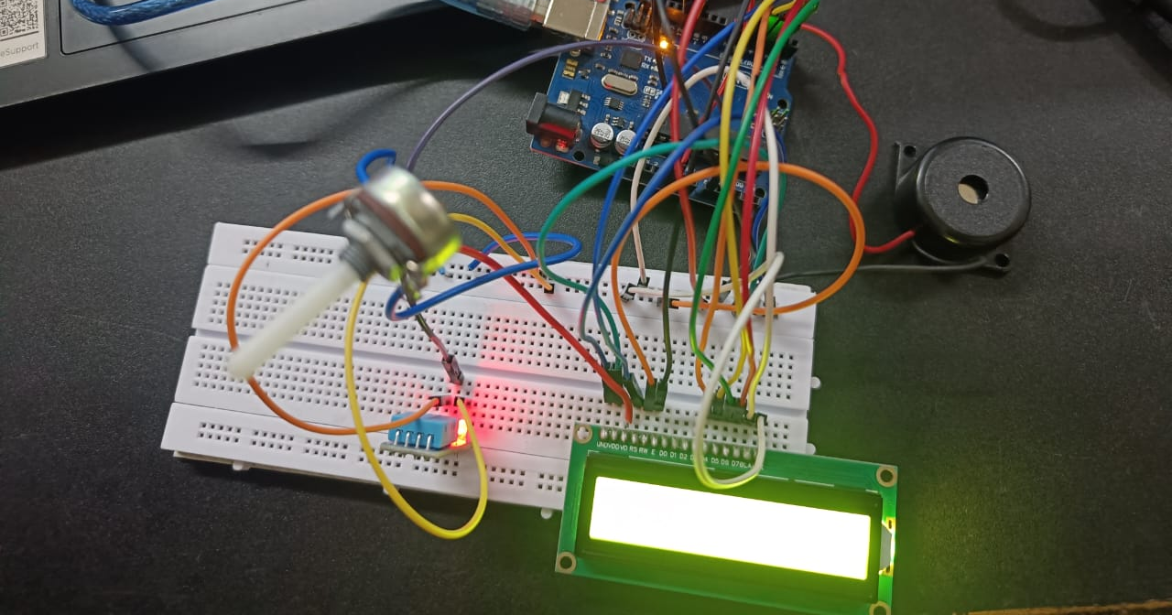

Slide 11
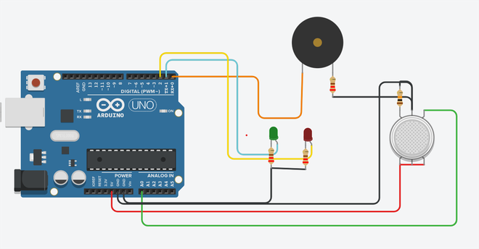

Slide 12
THANK YOU

